Slide 1
The Keyboard Keylogger
CSCE 436
Advanced Embedded Systems
By: Michael Martin & KokHwa Khor
4/26/2021

Slide 2
Problem Statement / Motivation
Need in surveillance technology to monitor and record each keystroke on a keyboard.
Use in businesses to troubleshoot, improve user experience, or monitor employees.
Use by hackers to monitor activity to give hackers access to your personal data
Such as passwords or credit card information

Slide 3
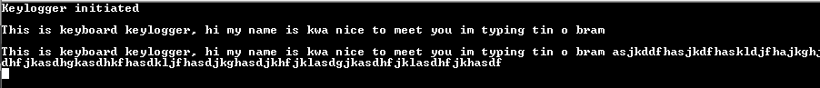
Technical Need and Objective
Capture keyboard presses, decode it, and store it as memory in Nexys Video FPGA board
Maximum of 4096 data stored in BRAM
Able to export all the data in 1024 chunks and print to Tera Term
Nexys Video board can be boot from an SD card
As a standalone device without having to program it everytime

Slide 4
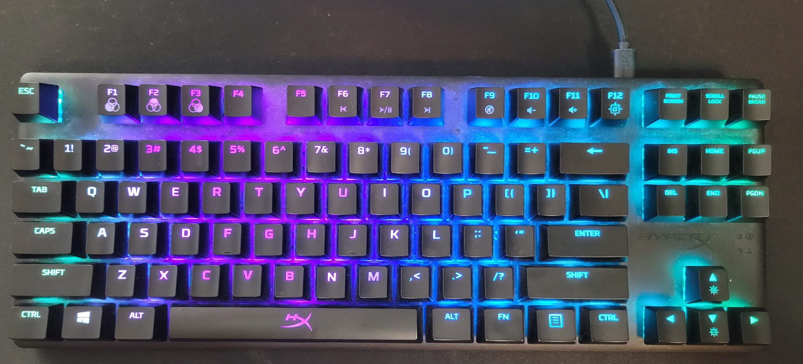
Initial Plan
Use an RGB keyboard
Control the LEDs colors on the keyboard through switches in FPGA
Realized Nexys Video USB HID only work with standard USB/PS2 compatible keyboard

Slide 5
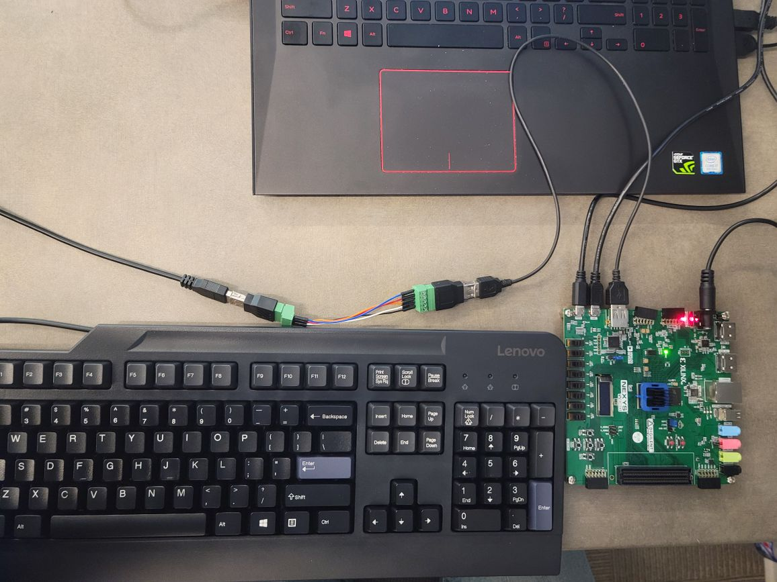
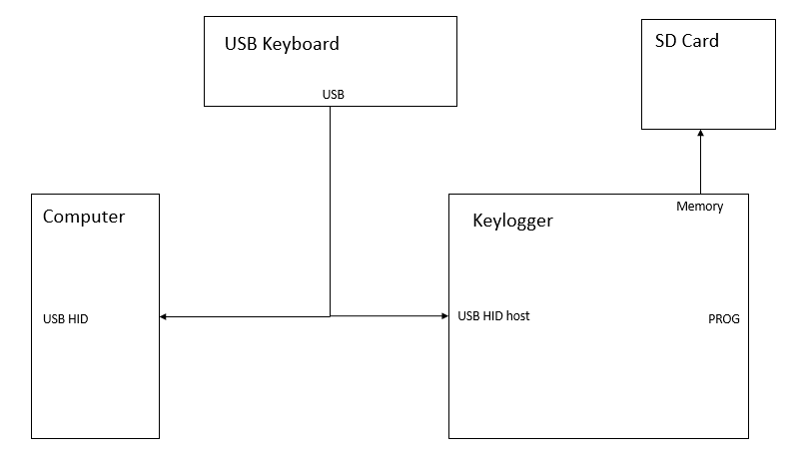
Level-0 Design

Slide 6
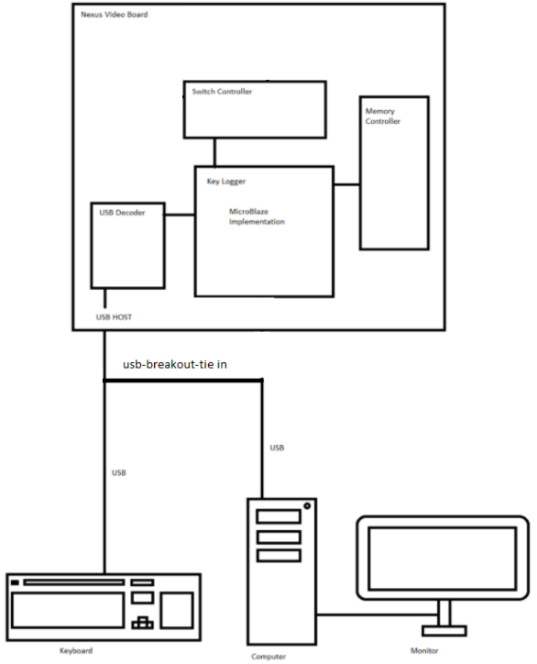
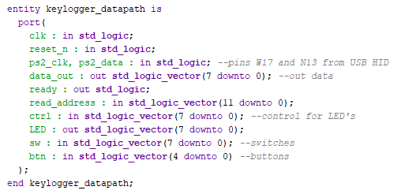
Level-1 Design

Slide 7
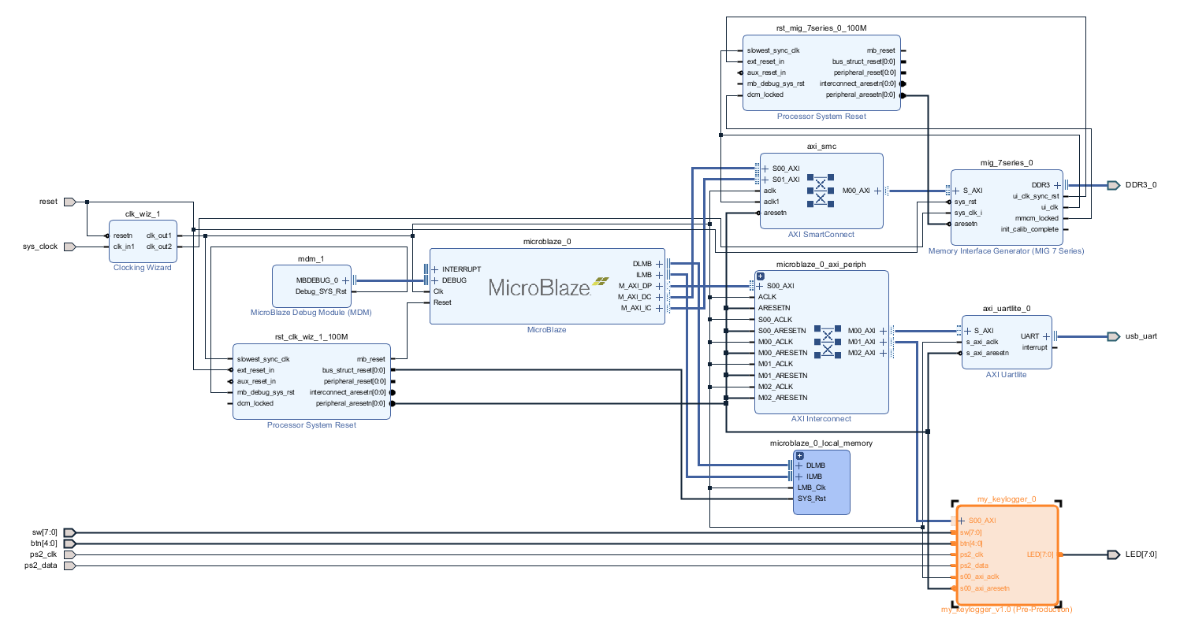
Block Diagram

Slide 8
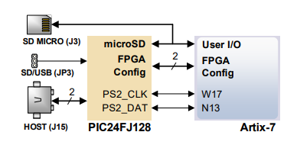
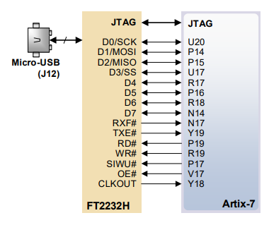
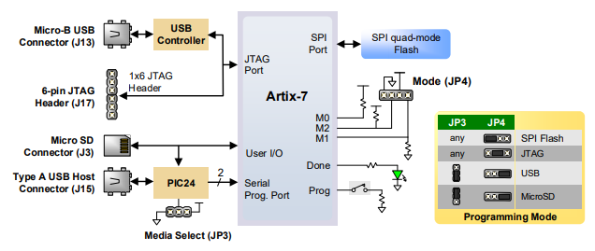
Datapath & Control

Slide 9
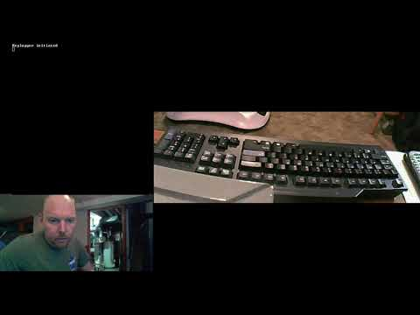
Video Demo

Slide 10
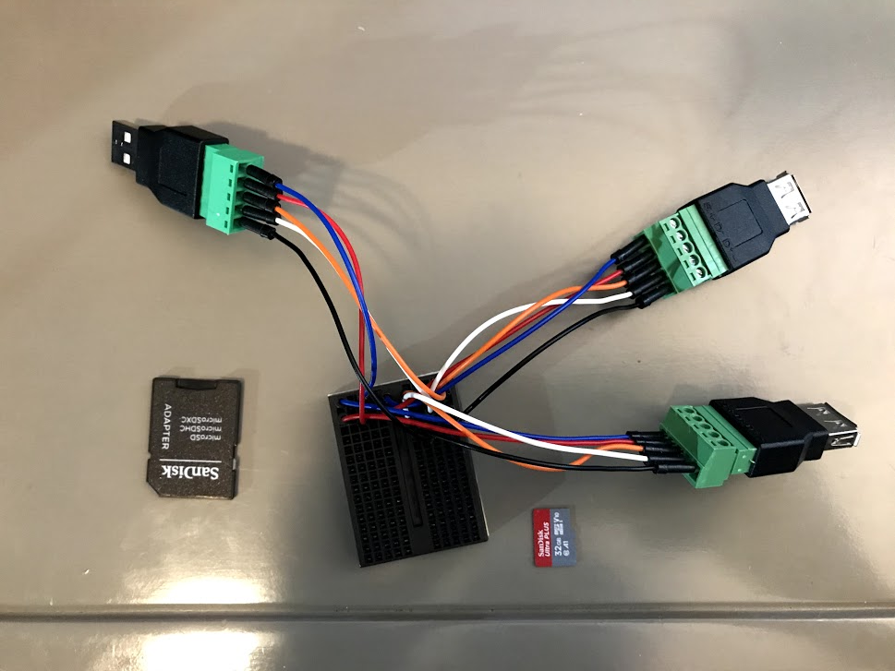
Functionality
Achieved
Read keypresses
Stored to memory (4096 char)
Output memory over UART
Program via SD card
Roll-over of memory
Un-achieved
Controlling LED’s
Passive interception of signal

Slide 11

References
Nexys Video™ FPGA Board Reference Manual

Slide 12

Questions?

